Slide 1
WORKING WITH MongoDB OVER CLOUD
1
Managing our data over the cloud offers flexible, affordable and scalable database management.
Development teams working with large data sets can store their data on the cloud; this ensures that critical massive data is stored reliably.
2
There are two possible ways to work with MongoDB on cloud:
Software as a Service
Infrastructure as a Service
3
4

Slide 2
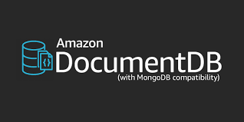
WORKING WITH MongoDB OVER CLOUD
Platform as a Service: Uses a platform-based service such as Amazon Document DB, which is massively scalable.
Amazon Document DB is cloud database service, which is compatible with MongoDB. It is a fast, scalable, highly available and fully managed document database service that supports MongoDB workloads.
Amazon Document DB makes it easy to store and query JSON data as it is a document database.
Amazon Document DB does not currently have a free tier; thus, creating a cluster will incur costs.
We can access Amazon Document DB resources from within the cluster’s VPC only. So, it becomes quite tricky to connect to the Document DB cluster from our local system.

Slide 3
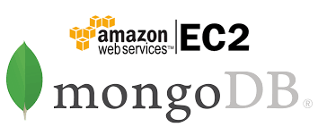
WORKING WITH MongoDB OVER CLOUD
Infrastructure as a Service: We can create our own custom-made service using Amazon EC2 instance and work with MongoDB there.
This helps in setting up a database as per individual requirements, thus reducing cost.

